Slide 1
Module 3: Lesson 5 MapReduce Programming

Slide 2
MapReduce Framework Programming Models
Java
Hadoop Streaming
A utility that comes with the Hadoop distribution
Maximum flexibility
Fastest performance
Native to MapReduce (which is implemented in Java)
Most difficult to write
Allows you to create and run MapReduce jobs with any executable or script as the mapper and/or the reducer
Transparent communication with the MapReduce framework though stdin and stdout

Slide 3
MapReduce Programming Java
The MapReduce framework is mainly written in the Java and that is the native language in which jobs using the framework are written
The advantage of using Java that is provided maximum flexibility and options for customization and also the fastest performance
From our perspective, using Java to code mapreduce jobs is less than ideal
It requires significant boiler plate to configure a job to run and, as a result, the code is verbose and difficult to read
Most importantly, this verbosity obscures concepts behind a lot of notation

Slide 4
MapReduce Programming WordCount in Java
package org.apache.hadoop.examples;
import java.io.IOException;
import java.util.StringTokenizer;
import org.apache.hadoop.conf.Configuration;
import org.apache.hadoop.fs.Path;
import org.apache.hadoop.io.IntWritable;
import org.apache.hadoop.io.Text;
import org.apache.hadoop.mapreduce.Job;
import org.apache.hadoop.mapreduce.Mapper;
import org.apache.hadoop.mapreduce.Reducer;
import org.apache.hadoop.mapreduce.lib.input.FileInputFormat;
import org.apache.hadoop.mapreduce.lib.output.FileOutputFormat;
import org.apache.hadoop.util.GenericOptionsParser;
public class WordCount {
public static class TokenizerMapper
extends Mapper<Object, Text, Text, IntWritable>{
private final static IntWritable one = new IntWritable(1);
private Text word = new Text();
public void map(Object key, Text value, Context context
) throws IOException, InterruptedException {
StringTokenizer itr = new StringTokenizer(value.toString());
while (itr.hasMoreTokens()) {
word.set(itr.nextToken());
context.write(word, one);
}
}
}
public static class IntSumReducer
extends Reducer<Text,IntWritable,Text,IntWritable> {
private IntWritable result = new IntWritable();
public void reduce(Text key, Iterable<IntWritable> values,
Context context
) throws IOException, InterruptedException {
int sum = 0;
for (IntWritable val : values) {
sum += val.get();
}
result.set(sum);
context.write(key, result);
}
}
public static void main(String[] args) throws Exception {
Configuration conf = new Configuration();
String[] otherArgs = new GenericOptionsParser(conf, args).getRemainingArgs();
if (otherArgs.length < 2) {
System.err.println("Usage: wordcount <in> [<in>...] <out>");
System.exit(2);
}
Job job = Job.getInstance(conf, "word count");
job.setJarByClass(WordCount.class);
job.setMapperClass(TokenizerMapper.class);
job.setCombinerClass(IntSumReducer.class);
job.setReducerClass(IntSumReducer.class);
job.setOutputKeyClass(Text.class);
job.setOutputValueClass(IntWritable.class);
for (int i = 0; i < otherArgs.length - 1; ++i) {
FileInputFormat.addInputPath(job, new Path(otherArgs[i]));
}
FileOutputFormat.setOutputPath(job,
new Path(otherArgs[otherArgs.length - 1]));
System.exit(job.waitForCompletion(true) ? 0 : 1);
}
}

Slide 5
Hadoop Streaming
But Hadoop provides API for writing MapReduce programs in languages other than Java
Hadoop Streaming is the utility that allows us to create and run MapReduce jobs with any script or executable as the mapper or the reducer
It uses Unix streams (stdin/stdout) as the interface between the Hadoop and our MapReduce program
So that we can use any language which can read standard input and write to standard output for writing our MapReduce program
Allows developers to leverage their existing knowledge in scripting languages, without the need to learn Java or the complexities of its use for MapReduce

Slide 6
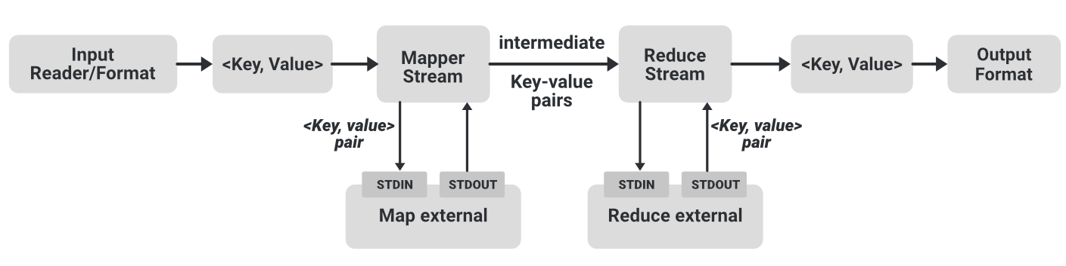
Hadoop Streaming
Here the Mapper and Reducer are both separate executables in any language
They both read input, line by line, from the standard input (stdin), and write output to the standard output (stdout)
The Hadoop streaming utility creates a MapReduce job, submits the job to the cluster, and monitors its progress until complete.

Slide 7
MapReduce Programming Python (MrJob)
MrJob is a library that provides a simplified Python language interface for running Hadoop Streaming jobs
It is open sourced and maintained by Yelp, well documented and can run locally, or in the cloud (ex. Amazon EMR)
It abstracts away the complexities of Hadoop Streaming and stream processing, allowing developers to focus on the logic of their data processing tasks
It eliminates the need for developers to write low-level Java code or deal with Hadoop configurations
It provides a concise and Pythonic syntax for coding mapper, reducer, and combiner functions, making it easier to develop and understand MapReduce jobs
Note, MrJob can execute Apache Spark jobs, but this is not a common use and we witll not explore this further

Slide 8
MapReduce Programming Python (MrJob) – Limitations
Lesser performance means it is not appropriate to process huge volumes of data (verses coding the same job in Java)
Simplified execution model makes it challenging to perform SQL-like joins or other similar operations on multiple input datasets
But it is very useful for our purposes to gain practical experience coding MapReduce jobs without the complications of Java

Slide 9
WordCount Using MRJob Driver
The first chunk of code we’ll look at is the driver.
The driver takes all of the components that we’ve built for our MapReduce job and pieces them together to be submitted to execution
This code is usually pretty generic and considered “boiler plate.”
You’ll find that in all of our patterns the driver stays the same for the most part

Slide 10
Using MRJob Driver
This (_) is a Python idiom to ignore the function argument
from mrjob.job import MRJob
class MRClassName(MRJob):
def mapper(self, _, value):
// some mapper logic
def reducer(self, key, values):
// some reducer logic
if __name__ == '__main__':
MRClassName.run()
“_” is the key of the input key value pair
“value” is the value of the input key value pair
“key” is the key of the input key value pair
“values” is an iterable to the collection value of the input key value pair

Slide 11
WordCount Using MrJob Mapper
Next is the mapper code that parses and prepares the text
The text string is split up into a list of words
Then the intermediate key produced is the word and the value produced is simply “1.”
This means we’ve seen this word once.
Even if we see the same word twice in one line, we’ll output the word and “1” twice and it’ll be taken care of in the end
Eventually, all of these ones will be summed together into the global count of that word

Slide 12
WordCount Using MrJob Mapper
The mapper is where we’ll see most of the work done.
We don’t care about the key of the input in this case which is the file offset of the next record read
The input value (and key) are strings
If you need to process the value (or part of it) as a float, integer or some other type you need to do the conversion yourself
Our output key and value must also be strings

Slide 13
WordCount Using MrJob Mapper
from mrjob.job import MRJob
class MRWordCount(MRJob):
def mapper(self, _, line):
words = line.split(“ “)
for word in words:
yield (word.lower(), 1)

Slide 14
WordCount Using MrJob Reducer
Next comes the reducer code, which is relatively simple
The reduce function gets called once per key grouping, in this case each word
We’ll iterate through the values, which will be numbers, and take a running sum
The final value of this running sum will be the sum of the ones
As in the mapper the key is a string

Slide 15
WordCount Using MrJob Reducer
The reduce function has a different signature from map, though
It gives you an Iterator over values instead of just a single value
This is because you are now iterating over all values that have that key instead of just one at a time
The key is very important in the reducer of pretty much every MapReduce job, unlike the input key in the map
Each reducer will create one file
So if you want to coalesce them together you’ll have to write a post-processing step to concatenate them

Slide 16
WordCount Using MrJob Reducer
def reducer(self, word, counts):
yield (word, sum(counts))

Slide 17
Canonical Word Count in Python (MrJob)
from mrjob.job import MRJob
import re
WORD_RE = re.compile(r"[\w']+")
class MRWordCount(MRJob):
def mapper(self, _, line):
for word in WORD_RE.findall(line):
yield (word.lower(), 1)
def reducer(self, word, counts):
yield (word, sum(counts))
if __name__ == '__main__':
MRWordCount.run()

Slide 18
WordCount Using MrJob Executing the Program
To execute a program on an existing EMR cluster from the primary (master) node:
python WordCount.py -r hadoop hdfs://my_home/input.txt -o hdfs://my_home/outdir
Note, if you do not include an output directory, the results will be written to the console
python WordCount.py -r hadoop hdfs://my_home/input.txt
This is what you might want for testing (or assignments) when the output is expected to be minimal

Slide 19
MapReduce Limitations
One limitation of the MapReduce capability is that is requires its users to be programmers
Another is that all problems need to be decomposed into one or more MapReduce steps
One needs to “think” in MapReduce terms
Often leads to lengthy map reduce programs
Data analysts and business users could better leverage the power of Hadoop if there was a means to hide some of the complexities of MapReduce
To address this need there are a growing number of tools such as Apache Hive and Apache Pig that hide the messy details of MapReduce
Using a range of abstractions much like compilers hide the details of machine language under high level language abstractions

Slide 20
MapReduce Limitations
Very rigid data flow model—map and then reduce
Not all processing fits easily into this single pattern
Limits each job to a single map and a single reduce step after which data is written back to HDFS
Makes machine learning algorithms which require iteration of several MapReduce jobs lower performing
Does not take advantage of caching intermediate results to memory between iterations
Makes MapReduce most appropriate for algorithms which run in a sequence of a few batch jobs
But MapReduce is not well suited to iterative jobs or any jobs requiring low latency real-time or interactive characteristics

Slide 21
MapReduce Limitations
Batch Processing
MapReduce in discrete batches rather than interactively or in real-time. This can lead to delays in obtaining insights from data, which can be a disadvantage for businesses (or research initiatives) that require real-time decision-making.
Programming Flexibility
MapReduce's programming model is relatively restrictive, limiting the flexibility of user-defined functions. More advanced data processing frameworks, such as Apache Spark, offer more flexibility and control over data processing logic.
Iterative Algorithms
MapReduce is not well-suited for iterative algorithms that require multiple passes over the data. Each pass (job) requires data to be read, processed, and written back to storage, which can introduce significant overhead into data processing pipeline
In-Memory Processing
MapReduce primarily operates on disk-based data, which can limit performance for applications that require in-memory processing for low-latency calculations and data transformations
Data Structures
MapReduce is designed to handle basic data structures, such as key-value pairs, and may not be efficient for processing complex data structures, such as graphs or nested objects
Skillset
Implementing and managing MapReduce jobs requires specialized skills and knowledge of distributed systems and programming. This can limit the availability of resources and expertise within organizations

Slide 22
Movie Rating Count Using MrJob
How many of each movie rating exist?
That is, how many times does the rating 1, 2, 3, 4, and 5 appear in the data set
Movie rating:
1 to 5 stars
USER ID | MOVIE ID | RATING | TIMESTAMP
196 | 242 | 3 | 881250949
186 | 302 | 3 | 891717742
196 | 377 | 1 | 878887116
244 | 51 | 2 | 880606923
166 | 346 | 1 | 886397596
186 | 474 | 4 | 884182806
186 | 265 | 2 | 881171488
For instance, rating “3” occurs 2 times

Slide 23
Movie Rating Count Using MrJob Map Phase
How many of each movie rating exist?
For each record output the key value pair
<rating, 1>
USER ID | MOVIE ID | RATING | TIMESTAMP
196 | 242 | 3 | 881250949
186 | 302 | 3 | 891717742
196 | 377 | 1 | 878887116
244 | 51 | 2 | 880606923
166 | 346 | 1 | 886397596
186 | 474 | 4 | 884182806
186 | 265 | 2 | 881171488
<rating, 1>
<1, 1>
<1, 1>
<2, 1>
<2, 1>
<3, 1>
<3, 1>
<4, 1>
Mapper

Slide 24
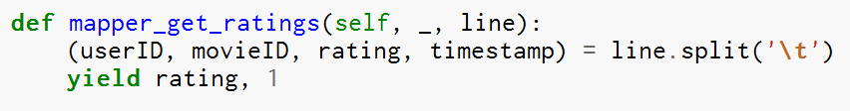
Movie Rating Count Using MrJob Map Phase
How many of each movie rating exist?
For each record output the key value pair
<rating, 1>
Mapper

Slide 25
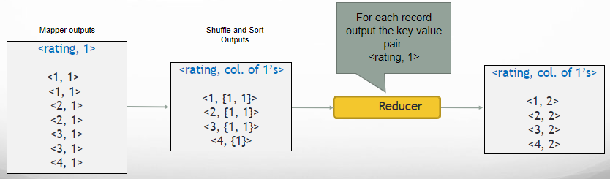
Movie Rating Count Using MrJob Reduce Phase
How many of each movie rating exist?

Slide 26

Movie Rating Count Using MrJob Reduce Phase
How many of each movie rating exist?
For each record output the key value pair
<rating, sum of 1’s>
Reducer

Slide 27
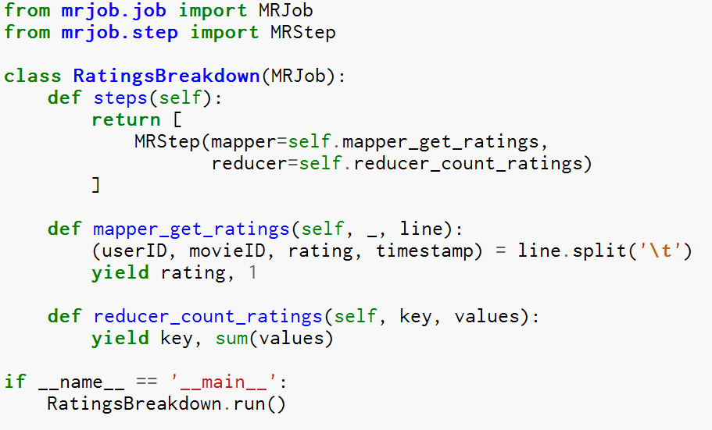
Movie Rating Count Using MrJob Putting it all together

